Slide 1
SQALE Quality model for ADA
SQALE quality requirements related to the Ada languages are listed out first before starting the analyze.
Some requirements are taken directly from the Quality model for example cyclomatic complexity, duplication code level. Some requirements are not directly mapped.
Efficiency is measured by two sub characteristics CPU performance, memory(RAM), memory (ROM) related.

Slide 2
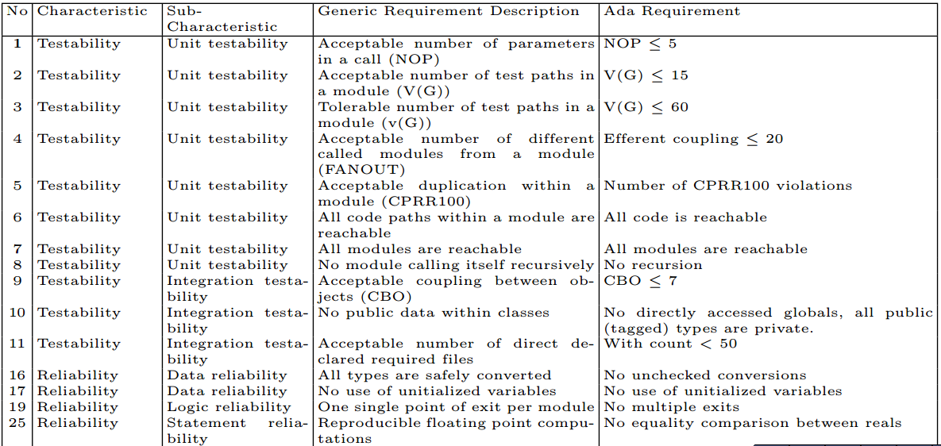

Slide 3
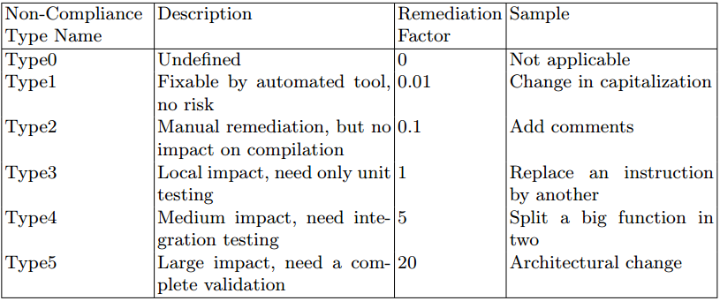

Slide 4
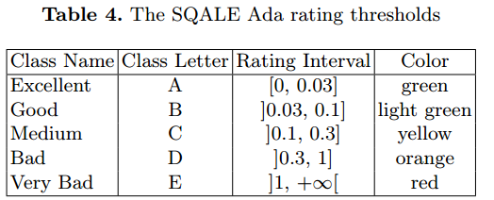

Slide 5
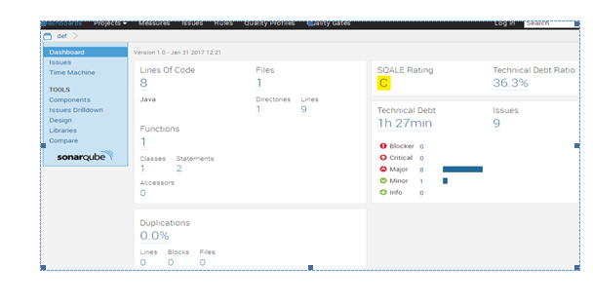

Slide 6
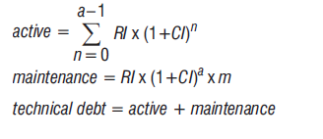

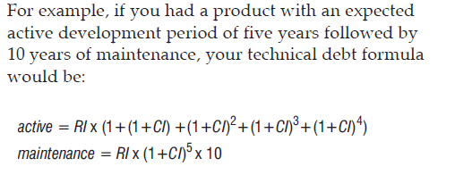
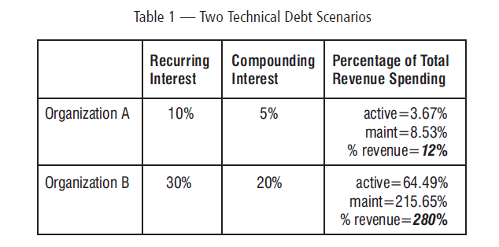
Technical Debt Calculation

Slide 7
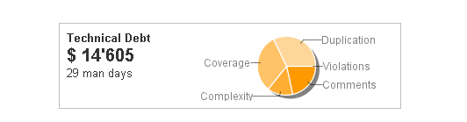

Slide 8
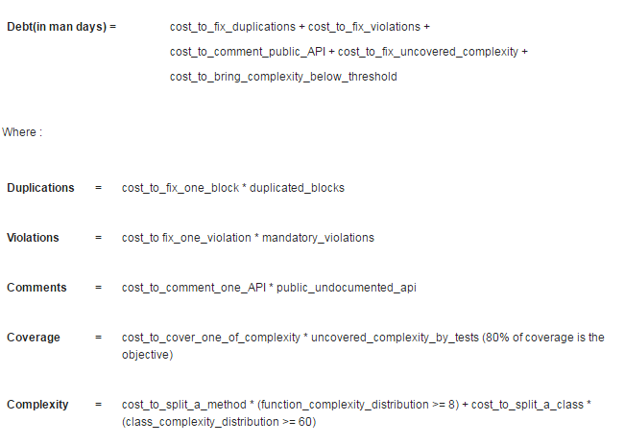

Slide 9
THANKU

